Slide 1
Paradigm Shifts in the
Care of Patients With Osteoporosis
This content was developed in concert with the scientific planning committee members:
David Kendler, MD, FRCPC, CCD Clinical Professor, Department of Medicine, University of British Columbia
Jonathan Adachi, MD, FRCPC Professor, Department of Medicine, McMaster University
Jeff Habert, MD, CCFP, FCFP Assistant Professor, Department of Family and Community Medicine, University of Toronto
Anne Morisset, MD, FRCPC Clinical Professor, Department of Medicine, Sherbrooke University
Christine Palmay, MD, CCFP Family Physician, Midtown Health and Wellness Clinic, Toronto, Ontario

Slide 2
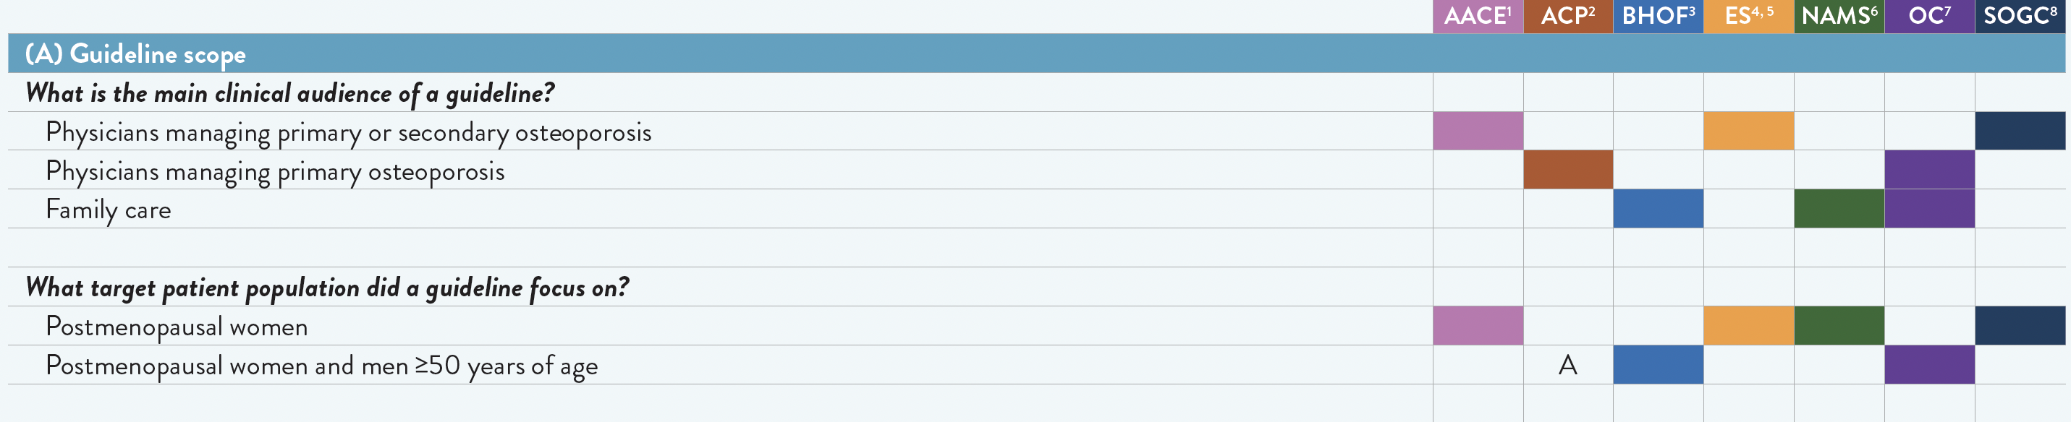
Key clinical questions for diagnosis and treatment of osteoporosis in adults ≥50 years of age – Summary of recent (2020–2023) guidelines – Guideline Scope

Slide 3
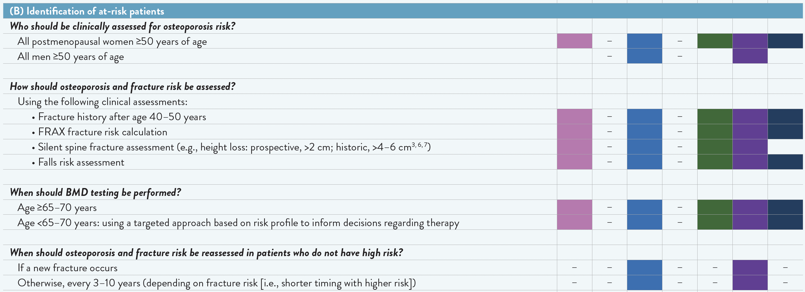
Key clinical questions for diagnosis and treatment of osteoporosis in adults ≥50 years of age – Summary of recent (2020–2023) guidelines – At-risk Patients

Slide 4
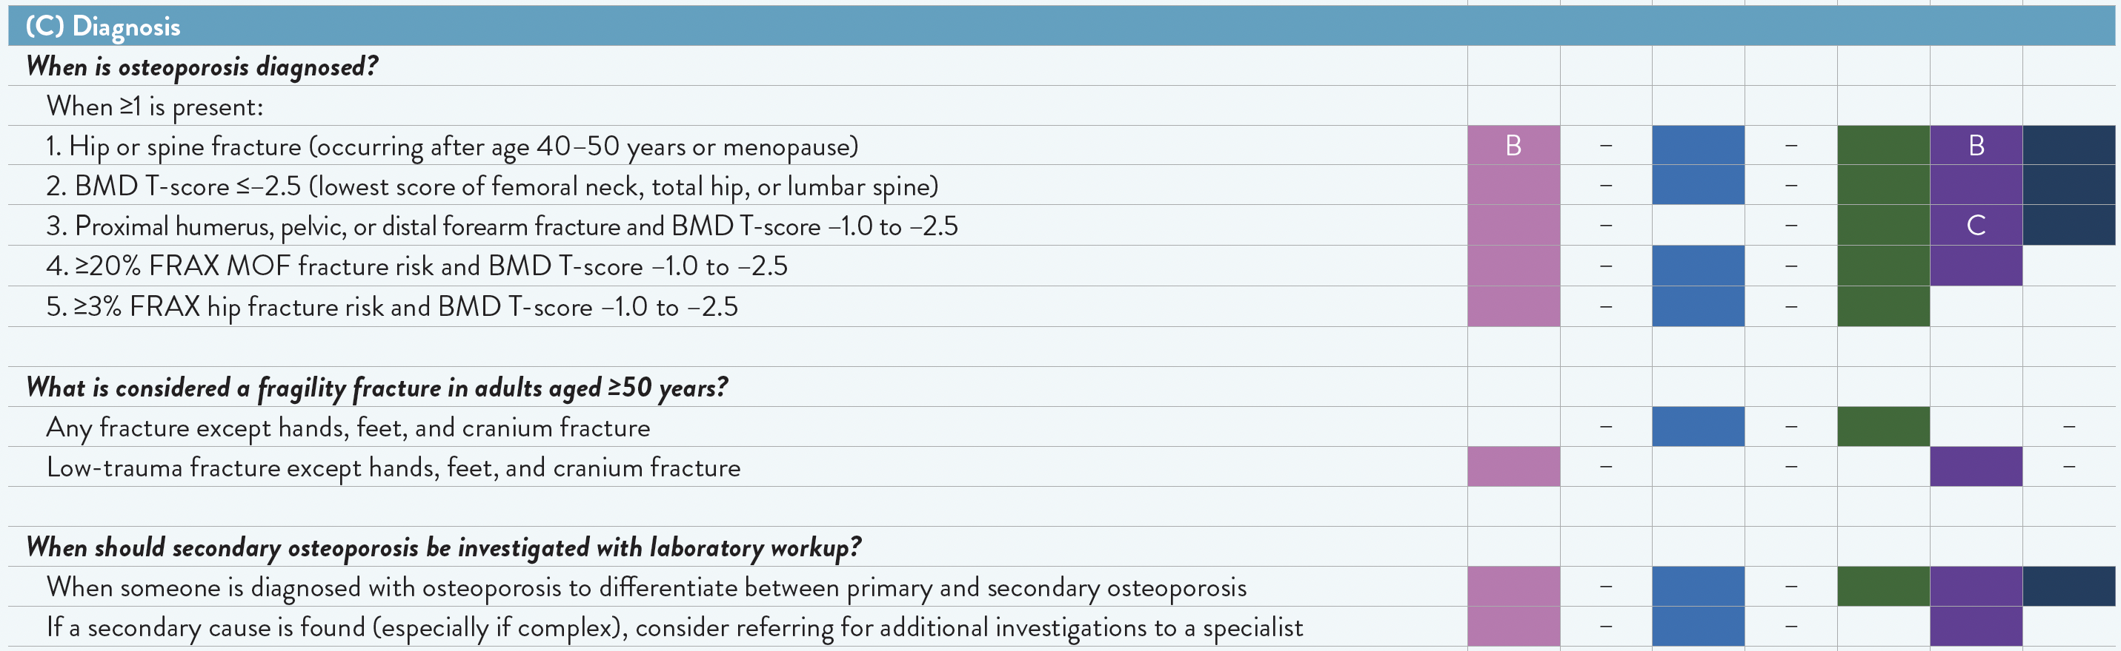
Key clinical questions for diagnosis and treatment of osteoporosis in adults ≥50 years of age – Summary of recent (2020–2023) guidelines – Diagnosis

Slide 5
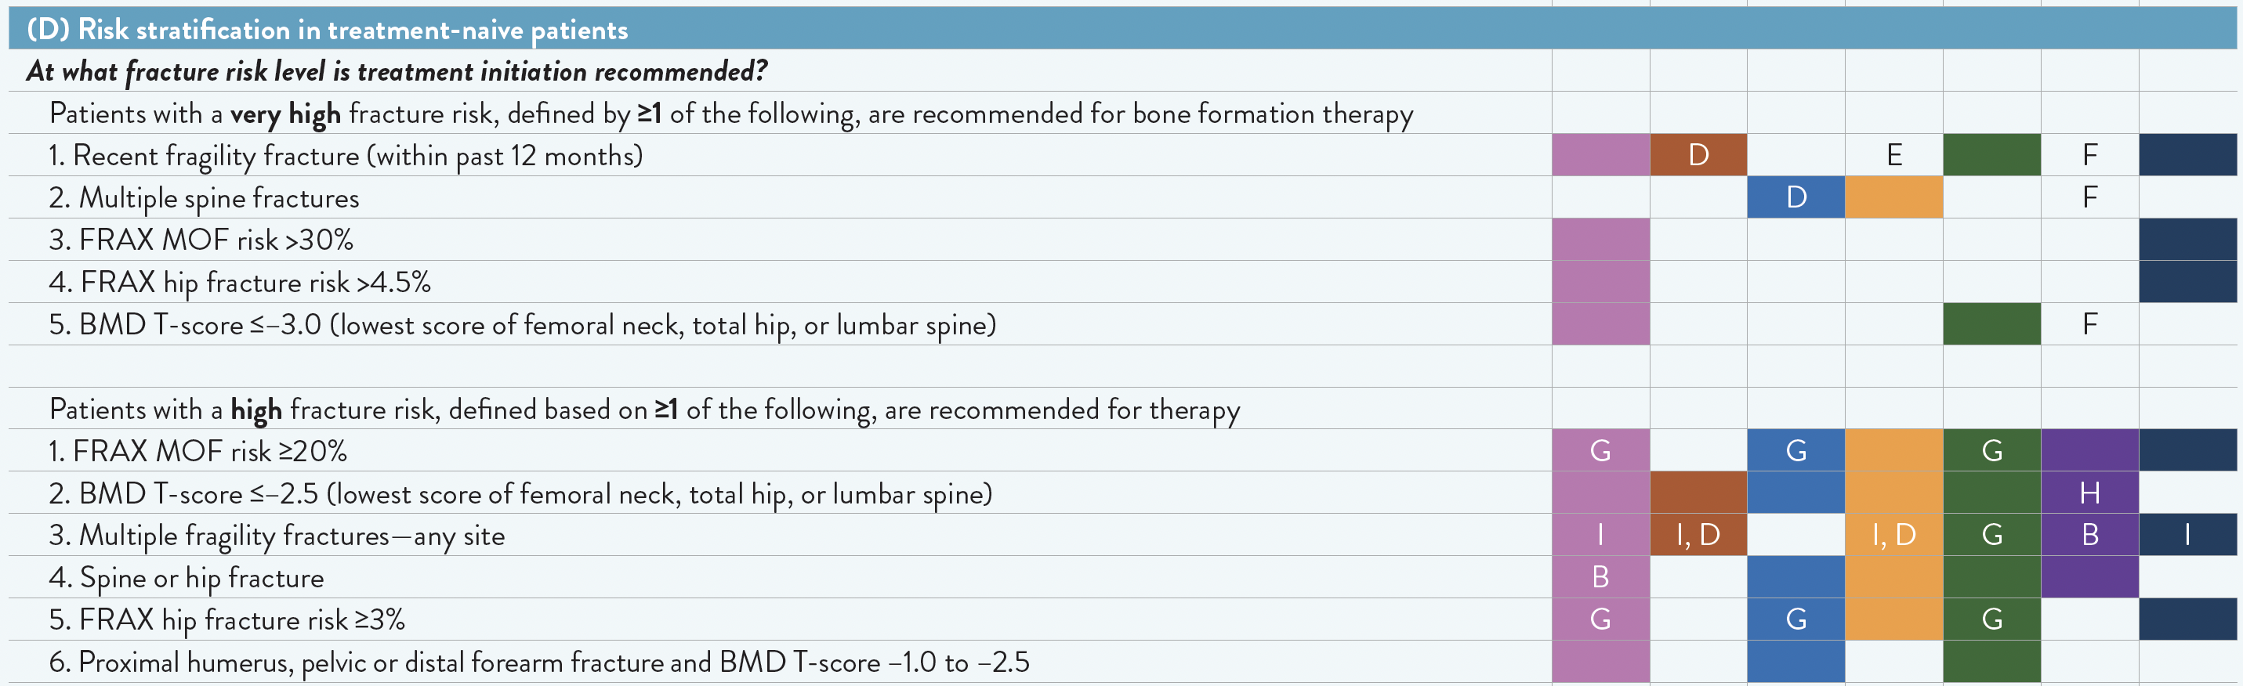
Key clinical questions for diagnosis and treatment of osteoporosis in adults ≥50 years of age – Summary of recent (2020–2023) guidelines – Risk Stratification

Slide 6
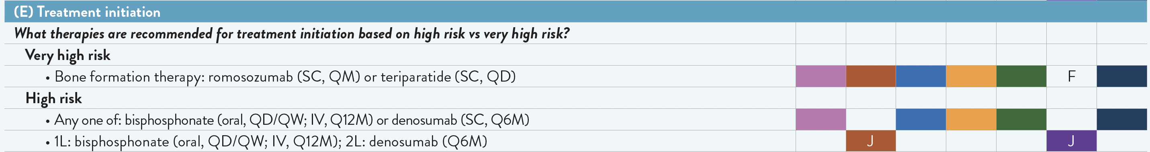
Key clinical questions for diagnosis and treatment of osteoporosis in adults ≥50 years of age – Summary of recent (2020–2023) guidelines – Treatment Initiation

Slide 7
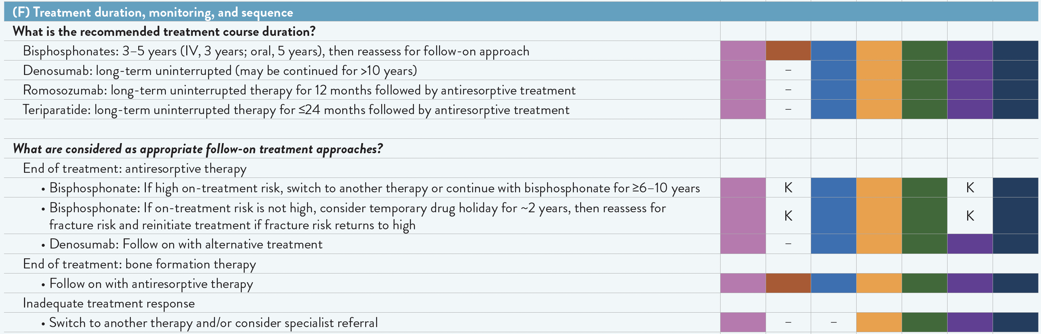
Key clinical questions for diagnosis and treatment of osteoporosis in adults ≥50 years of age – Summary of recent (2020–2023) guidelines – Treatment Monitoring

Slide 8
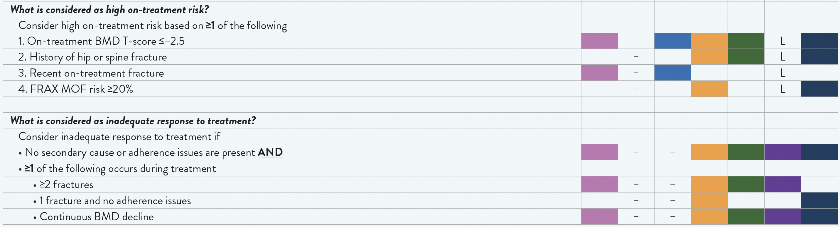
Key clinical questions for diagnosis and treatment of osteoporosis in adults ≥50 years of age – Summary of recent (2020–2023) guidelines – Treatment Monitoring

Slide 9
Key clinical questions for diagnosis and treatment of osteoporosis in adults ≥50 years of age – Summary of recent (2020–2023) guidelines – Footnotes
Footnotes (slides 2–8)
1L, first line; 2L, second line; AACE, American Association of Clinical Endocrinologists; ACP, American College of Physicians; BHOF, Bone Health and Osteoporosis Foundation (formerly National Osteoporosis Foundation); BMD, bone mineral density; ES, Endocrine Society; FRAX, fracture risk assessment tool; IV, intravenous; MOF, major osteoporotic fracture; NAMS, North American Menopause Society; OC, Osteoporosis Canada; Q6M, every 6 months; Q12M, every 12 months; QD, daily; QM, monthly; QW, weekly; SC, subcutaneous; SOGC, Society of Obstetricians and Gynaecologists of Canada.
– Question was not addressed by a guideline.
A: Guideline’s target patient population was adults with low bone mass or primary osteoporosis.
B: Conditional recommendation: if low-trauma fracture.
C: Guideline recommends only humerus or pelvic fracture and independent of BMD.
D: Conditional recommendation: if BMD T-score is ≤–2.5.
E: Guideline recommends initiating therapy without a delay in patients with a recent fracture (within past 2 years).
F: Guideline does not specify a “very high risk” category but recommends bone formation therapy for those with multiple spine fractures or a recent severe spine fracture and BMD T-score ≤–2.5; it also indicates that fracture risk calculators may underestimate fracture risk in patients with recent fragility fracture or BMD very low spine or total hip BMD.
G: Conditional recommendation: if BMD T-score is –1.0 to –2.5.
H: Conditional recommendation: if ≥70 years of age.
I: Guideline considers multiple fractures as indicating very high risk: AACE, ACP (if BMD T-score is ≤–2.5), ES (if BMD T-score is ≤–2.5), and SOGC.
J: Denosumab is recommended 1L treatment if barriers to bisphosphonates exist, such as high burden of oral medications, gastrointestinal intolerance, inability to be upright >30 minutes, hypocalcaemia, creatine clearance <30–35 mL/min, or esophageal abnormalities.
K: Alternative definition provided: OC recommends bisphosphonate holiday if there is adequate response and no ongoing substantial concern for fracture; ACP recommends individualized decision-making for bisphosphonate holiday, based on baseline risk for fracture, type of bisphosphonate and its half-life in bone, and the benefits/harms of discontinuation, including higher risk for fragility fracture.
L: Alternative definition provided: when there is inadequate response to therapy or ongoing substantial concern for fracture.

Slide 10
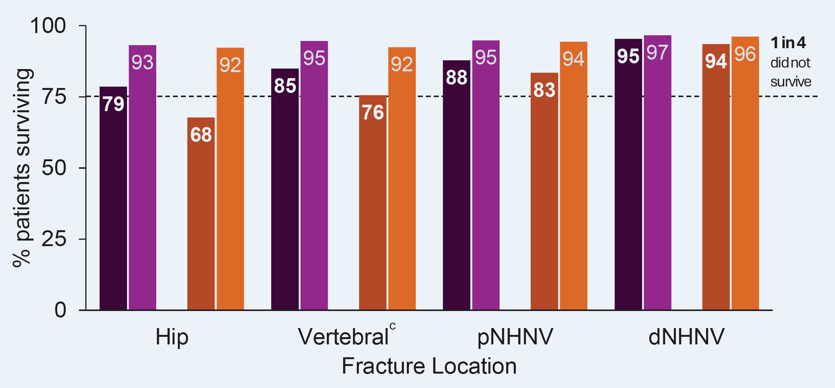
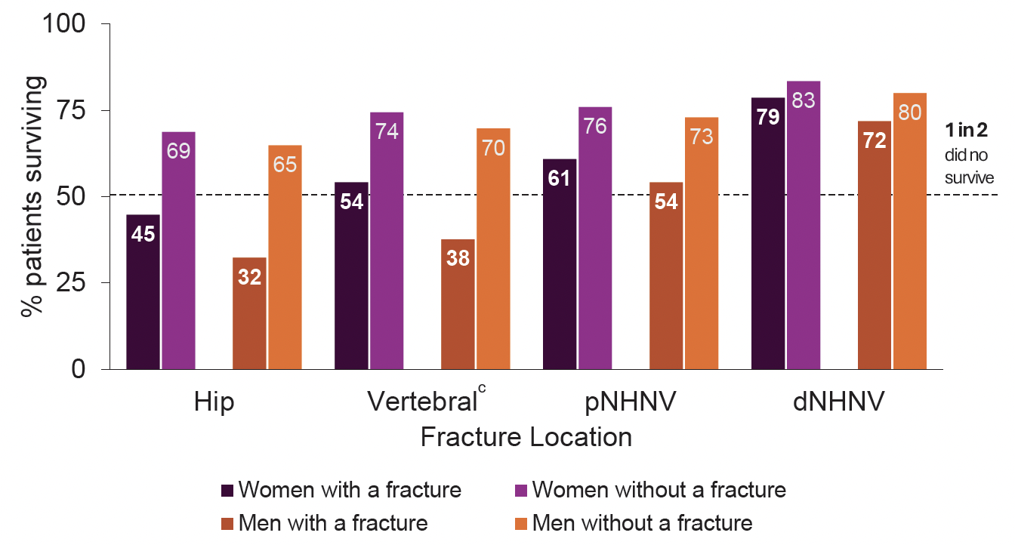
1-year survival rate in Ontarians >65 years of age after a fracture compared with matchedª individuals without a fracture (2011–2015)

Slide 11
5-year survival rate in Ontarians >65 years of age after a fracture compared with matchedª individuals without a fracture (2011–2015)

Slide 12
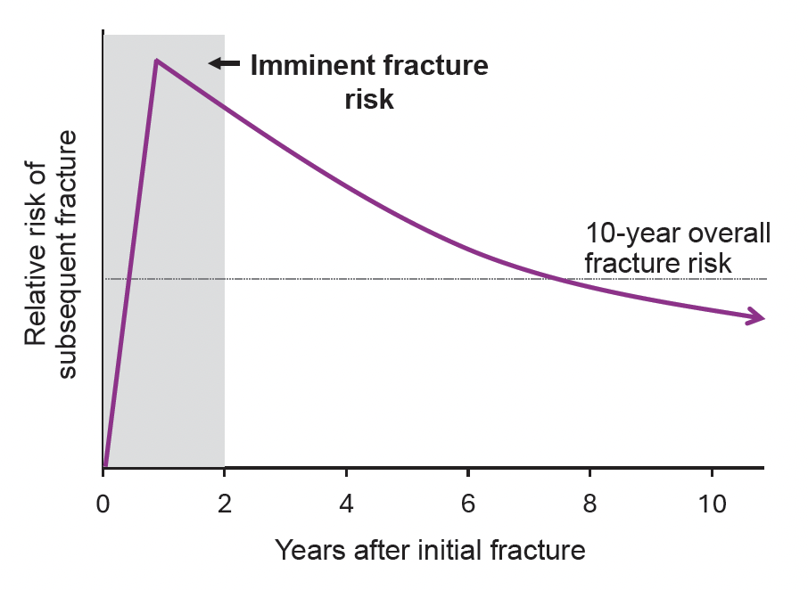
Subsequent fracture within 1 to 2 years after initial fracture: A schematic illustration of “imminent” fracture risk¹⁻⁶

Slide 13
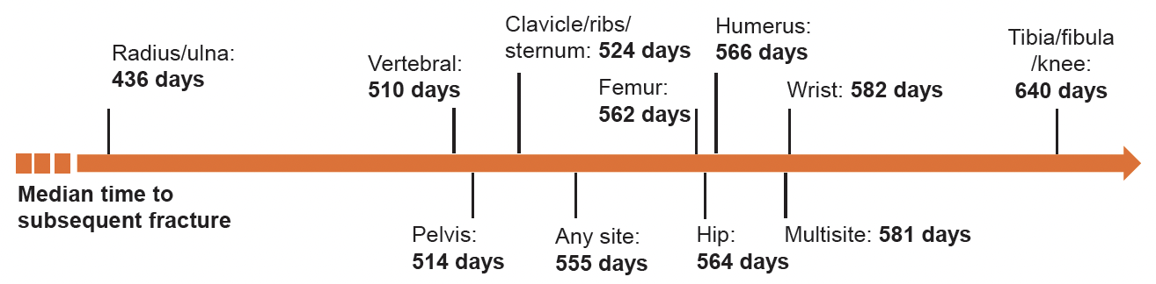
Subsequent fracture within 1 to 2 years after initial fracture: Median time (days) to subsequent fracture among 115,776 Ontarians >65 years of age by anatomic site of initial fracture

Slide 14
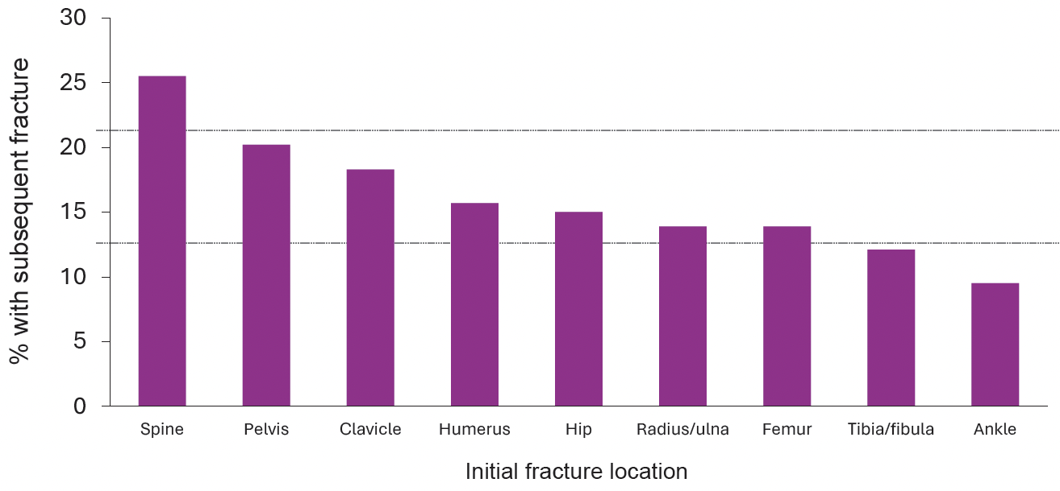
Subsequent fracture within 1 to 2 years after initial fracture: 2-year risk of subsequent fracture among 377,561 postmenopausal women ≥65 years of age in the US by anatomic location of initial fracture

Slide 15
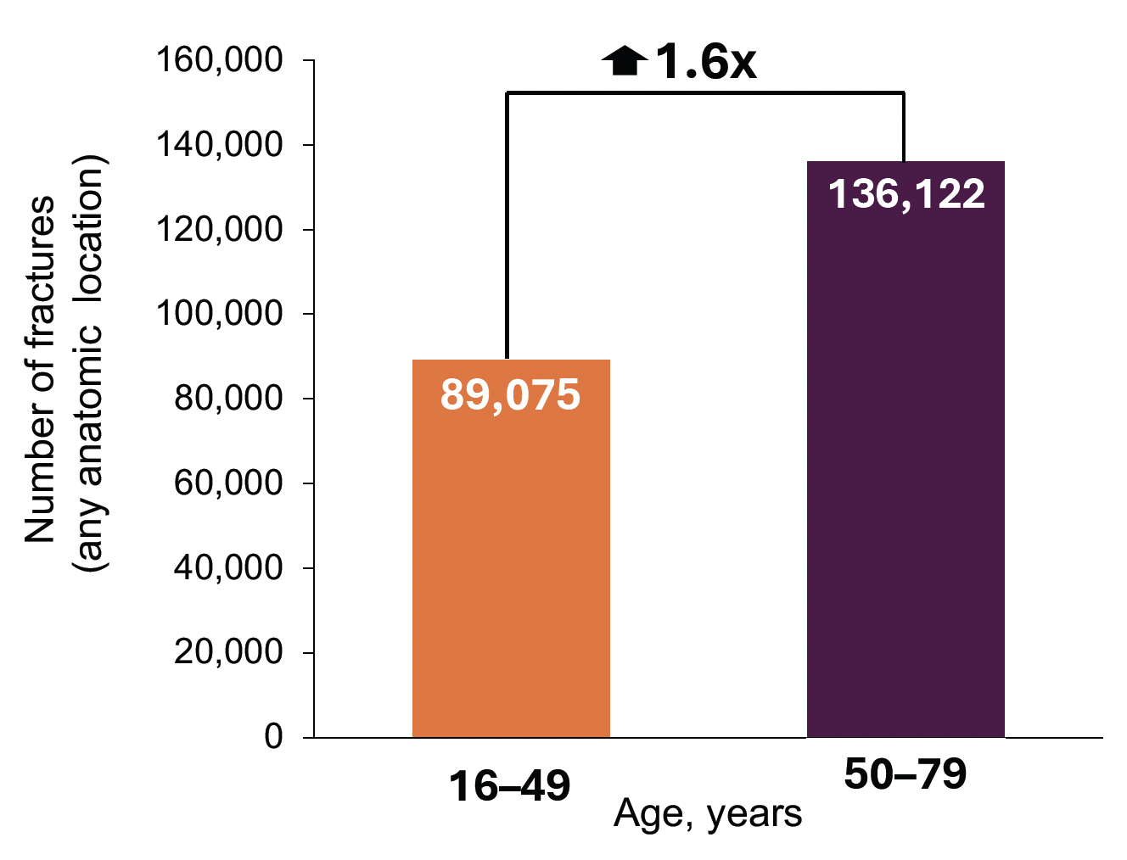
Increase in fracture numbers in older vs younger general adult population, Sweden, 2012–2018

Slide 16
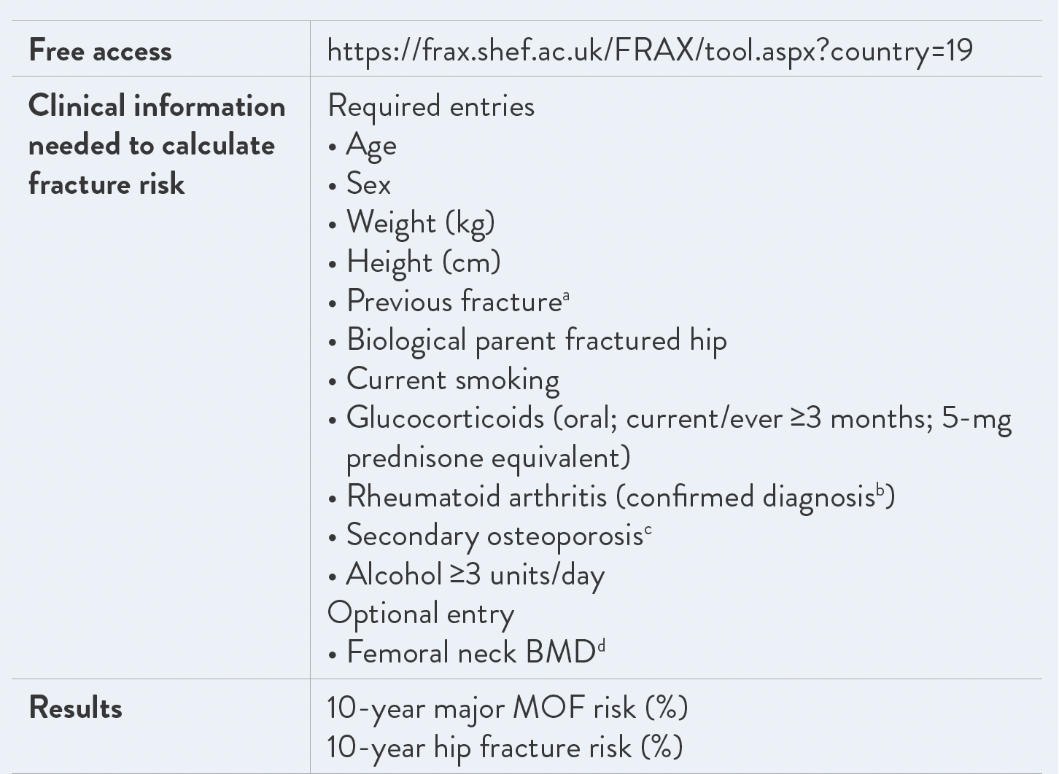
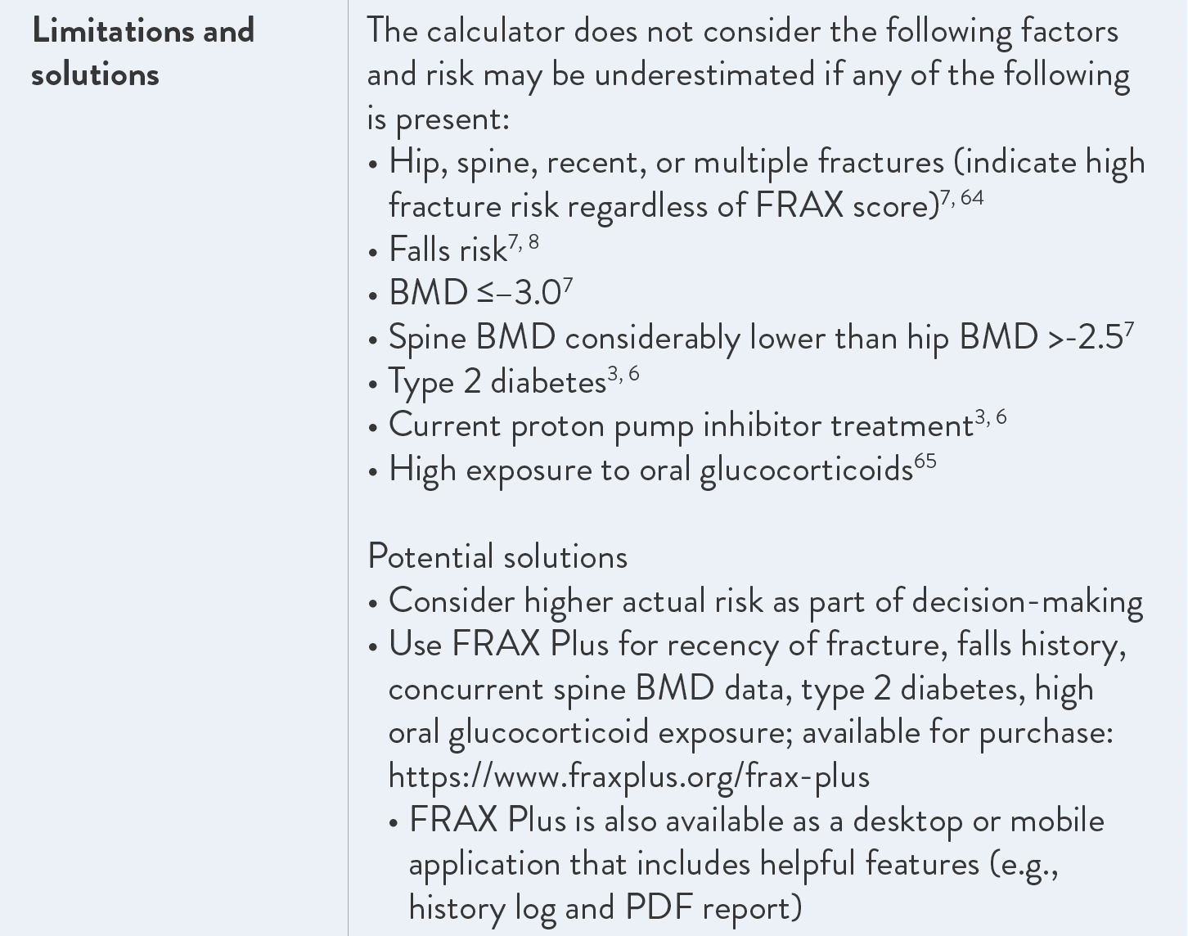
Canadian FRAX fracture risk calculator: Overview

Slide 17
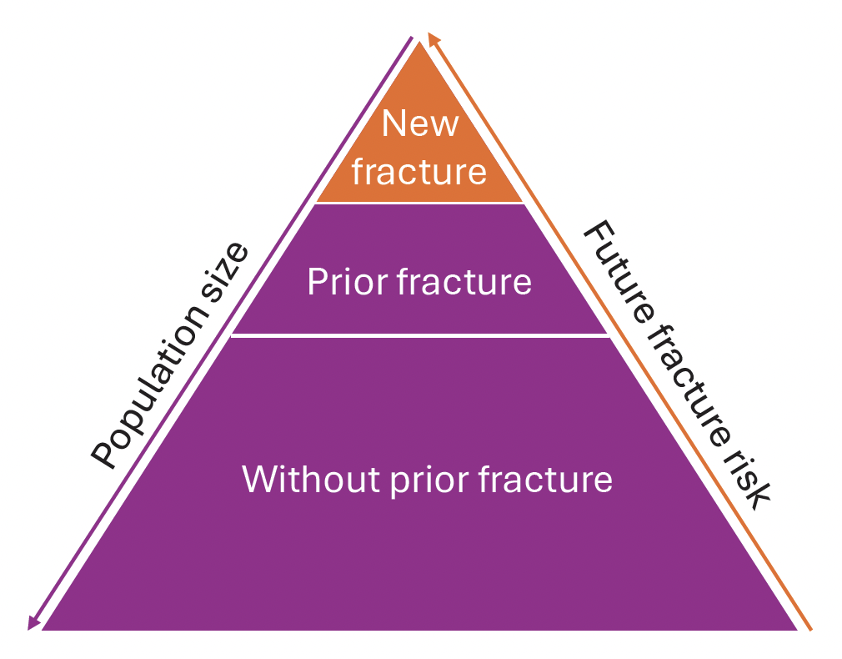
Osteoporosis and fracture prevention in Canadian population
As part of its population-level strategy of fracture prevention in Canada, the The Public Health Agency of Canada closely surveils fractures among Canadians ≥40 years of age and advocates for the International Osteoporosis Foundation’s approach to identifying at-risk individuals within the older adult population. This approach focuses on easy-to-identify individuals, or those presenting with a fracture.^{1,2}
As depicted here, these individuals make up a relatively small proportion of the population appropriate for fracture risk assessment yet have a high probability of experiencing another fracture.

